Slide 1

Excel Transport Business Case
Miracle Oghide

Slide 2
PROJECT BRIEF
We expect an extraordinary increase in passengers in Q1 of 2025, with flight prices increasing and many people switching to road transport. As a result, we need to increase our fleet size, the company only has the resources to double the fleet size.
Your analysis is required to achieve the following; Double the fleet size and Decide which routes should be prioritized
Review the four levers below, and determine what your action plan would be over the i) next week ii) next month iii) next 3 months to deliver maximum impact given a resource-constrained team. Assume you are responsible for implementing this project.
Context:
The four levers that we have to increase the size of the rider fleet are:
1. Applications: We get 100 applications per month- driven by a combination of offline and online sources.
2. Conversion: The conversion rate is ~30%, at the moment we are onboarding 30 drivers per month.
3. Engagement: Drivers complete 5 trips per week on average.
4. Churn: Roughly 10% of the fleet churns each month.

Slide 3
TARGETS & OBJECTIVES
100% fleet size increase in Q1 2025
Determine the priority of routes
Maximize Profits
Stay competitive in the market and position for sustained profitability
Efficient use of Resources
Manage resource constrained team to achieve the goals
Support future goals
Lay a foundation for expansion and fleet scalability
Ensure operational efficiency
Fully cater to the demand
Prevent underutilization of the new fleet
Mitigate Risks
Avoid unprofitable operations

Slide 4
Phase 1 – FIRST WEEK
Situation Exploration and Analysis
For the first week, our goal is to explore and understand the current situation, identify root causes of low applicant numbers, conversion issues and churn. We have to come up with a comprehensive diagnostic report and SMART action plan. Key questions that need to be answered in this stage include;
Why is our application numbers low? Can we increase it?
Why is conversion rate low?
How can we reduce churn?
ACTIONS POINTS
Data collection and analysis: Gather additional data on applicant demographics, rejected applications, exit interviews.
Review Current Processes with key teams: Work with HR department to review hiring and onboarding process and find out how improvements can be made for better conversion of drivers.
Marketing and communication strategies: Get together with marketing department to evaluate current advertising strategies. Collect feedbacks from recent hires to see what’s working, identify the best ways of spreading information and where improvements are needed.
Establishing Targets: Create targets for each metric at milestones, Set up teams and draw up preliminary budget for this project.

Slide 5
Detailed Target
Week | No. of driver (start of week) | No. of applicants | Conversion rate | No. of onboarded driver | No. of riders of drivers before churn) | Churn | No of churned drivers | No of drivers (end of week)
Week 0 | 142 | 25 | 30% | 8 | 150 | 2.50% | 4 | 146
Week 1 | 146 | 25 | 30% | 8 | 153 | 2.50% | 4 | 149
Week 2 | 149 | 25 | 30% | 8 | 157 | 2.50% | 4 | 153
Week 3 | 153 | 25 | 30% | 8 | 161 | 2.50% | 4 | 156
Week 4 | 156 | 35 | 45% | 16 | 172 | 2.50% | 4 | 168
Week 5 | 168 | 35 | 45% | 16 | 184 | 2.50% | 5 | 179
Week 6 | 179 | 35 | 45% | 16 | 195 | 2.50% | 5 | 190
Week 7 | 190 | 35 | 45% | 16 | 206 | 2.50% | 5 | 201
Week 8 | 201 | 45 | 55% | 25 | 225 | 2.00% | 5 | 221
Week 9 | 221 | 45 | 55% | 25 | 246 | 2.00% | 5 | 241
Week 10 | 241 | 45 | 55% | 25 | 265 | 2.00% | 5 | 260
Week 11 | 260 | 45 | 55% | 25 | 285 | 2.00% | 6 | 279
Week 12 | 279 | 50 | 65% | 33 | 312 | 2.00% | 6 | 305
** Detailed report on the Target can be found HERE
METRIC | CURRENT | GOAL
Applicants | 100 per month | 200 per Month
Conversion Rate | 30% monthly | 65% monthly
Churn | 10% monthly | 8% monthly

Slide 6
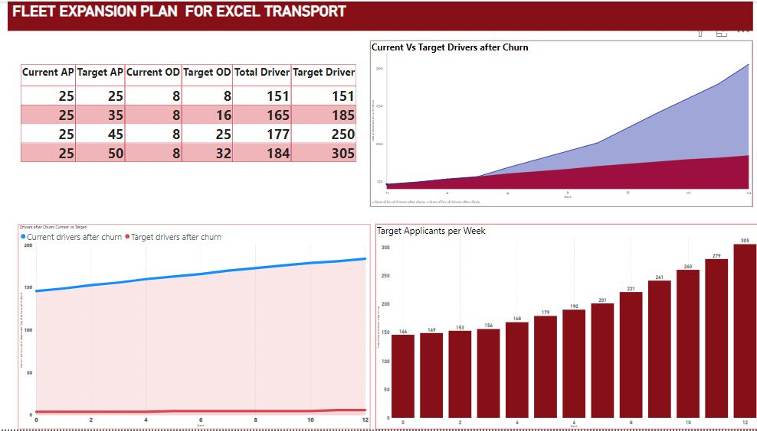

Slide 7
Phase 2– FIRST MONTH
Increasing Applicants, Conversion rate and Investigating Churn
In Weeks 2-4 our focus will shift from diagnostics (Phase 1) to implementing actionable solutions. We will execute recruitment strategies to increase application and conversion improvements while understanding what’s driving churn. We will collect weekly recruitment reports and conversion improvements.
ACTIONS POINTS
Optimize Marketing with targeting Campaigns: Launch Radio Jingles and flyers to target drivers. Focus on high performing digital channels to increase visibility and applicants.
Review Onboarding Process: Reduce the bottlenecks identified in the onboarding process. Include orientation and assign an old hire to mentor the new hire for the onboarding period on job processes and secrets.
Review the Ideal Applicant profile: Lower the minimum Age (from 45 to 40years) , Years of work experience (20years to 10-15years) and prioritize driving skills to educational qualification while maintaining quality and operational efficiency.
Launch Driver Referral Program: Referral bonus or points for drivers who bring other qualified drivers who get hired.
Follow-Up on Past Applicants: Send automated calls and emails to encourage previous unsuccessful applicants to with updates and reapplication opportunity.
Introduce Churn Management mechanism such as surveys and feedback forms to understand drivers’ concerns.

Slide 8
Phase 3 – FIRST QUARTER
Sustaining Growth and Reducing Churn
During week 4-12, our focus will be on reducing churn and maintaining the steady growth of both our applications and conversions.
ACTIONS POINTS
Churn Concerns: Address top concerns identified in earlier churn diagnostics and push to address it. Issues such as Pay rate, Insurance, Day off policies etc
Driver Support and feedback Program for both new and old hires to ensure that riders are engaged and heard. Assign representatives to drivers of a route to listen to them and relay their concerns to management, Schedule one-on-one meetings and make regular feedbacks and surveys.
Continued Marketing Optimization: To ensure steady growth, continue to optimize marketing strategies. Do market analysis to benchmark against competitors.
Collaborate for Driver’s care: Partner with restaurants to provide rest areas and meals for drivers at stopover points, improving morale and therefore reducing churn
Create Driver Loyalty Programs for high performing and engaging drivers with monetary and non monetary incentives such as extra day off, flexible scheduling, driver of the month spotlight.
Conduct Exit Interviews for drivers, analyze the causes and implement corrective actions.
Fleet Management and support: Pay extra attention on fleet care and management to enhance the driving experience and optimal performance of the driver.
Performance Tracking and Reporting: Develop a system for collecting weekly updates to monitor progress and productivity.

Slide 9
Prioritization of Routes
Routes | Newly Added Drivers | Expected size of passengers | Old Fleet Size | New Fleet Size | % Fleet Increase
Lagos-Port Harcourt | 35 | 500 | 11 | 46 | 320%
Lagos-Akwa Ibom | 24 | 400 | 19 | 43 | 126%
Lagos-Abuja | 21 | 500 | 21 | 42 | 101%
Lagos-Ogun | 18 | 300 | 14 | 32 | 131%
Lagos-Ibadan | 14 | 300 | 12 | 26 | 118%
Lagos-Enugu | 11 | 300 | 10 | 21 | 113%
Lagos-Anambra | 8 | 200 | 17 | 25 | 50%
Lagos-Kano | 4 | 300 | 9 | 13 | 47%
Lagos-Warri | 4 | 200 | 20 | 24 | 21%
Lagos-Sokoto | 0 | 200 | 8 | 8 | 0%
Totals | 141 | 3200 | 141 | 282 | 100%
Detailed data report on the routes can be found here; Route Report

Slide 10
Reasons for Prioritization
LAGOS – PORT HARCOURT with the highest fleet utilization and expecting the largest influx of customers is currently the top route to look out for. It is a highly competitive route and our best selling with customers. The 8% churn is worrisome considering the route is already in a tight spot.
LAGOS – AKWA IBOM has high growth potential with a forecasted influx of passengers and medium competition which offers room for market dominance. The route has strong fleet utilization, which ensures efficient use of resources. However, It has the highest churn is a critical issue that needs immediate attention to sustain growth and reliability.
LAGOS – ABUJA is already one of our top routes, highly competitive market, expecting large size of customer, has high number of trips and a high churn rate
LAGOS- OGUN has a high competitive market we need to stay on top of, handles a high number of trips but the drivers are leaving
LAGOS –IBADAN has a big fleet size with efficient utilization and expecting a good amount of customers, Medium competition offers room for more growth, Churn rate is high
LAGOS – ENUGU is expecting a sizable amount of customers, Churn at 12% is not a great look especially as the utilization is good. Medium Competition
LAGOS – ANAMBRA, 80% utilization of the small fleet, Medium competition, 9% churn
LAGOS – WARRI route currently utilizes just 60% of the very small fleet of buses (9). The churn of 12% is high and needs to be improved on but it has a lot of buses not being used. A little addition will be sufficient.
LAGOS - SOKOTO route has the lowest utilization of the very small fleet it has. It records low trips and low driver churn. It does not need extra buses. It has room for improvement.

Slide 11
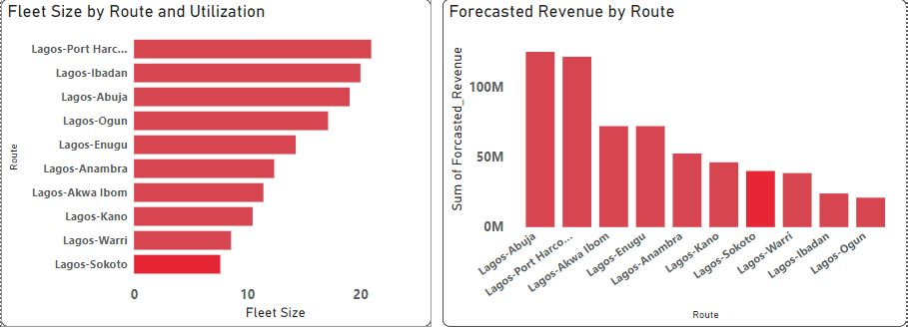
Route Visualization

Slide 12
CHECK IN (Follow Up)
Brief: After Three months of implementing the action plan, Excel Transport experienced an 85% increase in fleet size.
Did the Action Plan work? What would be a good way to access the effectiveness of the action plan?
While this outcome is a positive development, it cannot be entirely connected to the action plan without comprehensive analysis., external factors such as economic conditions or unrelated decisions may have also contributed to this growth.
By assessing the effectiveness of the plan, we will also be able to identify key areas for improvements.
To assess the effectiveness of the action plan, we would take the following steps:
Examine Timing and Trends: Connect the fleet size increase to specific parts of the action plan and identify other possible factors involved.
Analyze the weekly recruitment reports and monthly churn rate reports; Evaluate if initiatives like referral bonuses, training programs, and onboarding improvements reduced churn and attracted new drivers.
Route Optimization: Analyze the Performance on prioritized routes (e.g., revenue growth, fleet utilization, customer satisfaction} and Assess whether routes with growth potential and churn issues improved operational efficiency and profitability.
Collect Feedbacks: Gather input from key teams and drivers to understand their views on the effectiveness of the action plan.
Create Control Groups: Compare regions that implemented the action plan with those that did not to identify its direct effect.

Slide 13
THANK YOU
Do you have any questions?

